Slide 1

Chapter 6
The Normal Distribution

Slide 2
Objectives
In this chapter, you learn:
To compute probabilities from the normal distribution
How to use the normal distribution to solve business problems
To use the normal probability plot to determine whether a set of data is approximately normally distributed

Slide 3
Continuous Probability Distributions
A continuous variable is a variable that can assume any value on a continuum (can assume an uncountable number of values)
  thickness of an item
  time required to complete a task
  temperature of a solution
  height, in inches
These can potentially take on any value depending only on the ability to precisely and accurately measure

Slide 4
The Normal Distribution
‘Bell Shaped’
Symmetrical
Mean, Median and Mode
are Equal
Location is determined by the mean, μ
Spread is determined by the standard deviation, σ
The random variable has an infinite theoretical range:
+ ∞ to − ∞
f(X)
σ
X
μ
Mean
= Median
= Mode

Slide 5
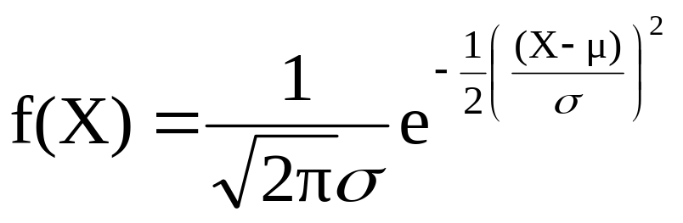
The Normal Distribution
Density Function
The formula for the normal probability density function is
Where e = the mathematical constant approximated by 2.71828
π = the mathematical constant approximated by 3.14159
μ = the population mean
σ = the population standard deviation
X = any value of the continuous variable

Slide 6
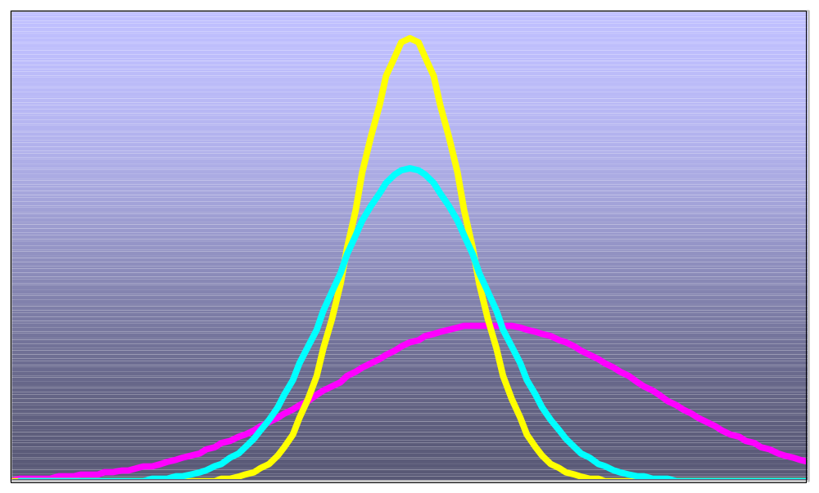
By varying the parameters μ and σ, we obtain different normal distributions
A
B
C
A and B have the same mean but different standard deviations.
B and C have different means and different standard deviations.

Slide 7
The Normal Distribution Shape
f(X)
Changing μ shifts the distribution left or right.
Changing σ increases or decreases the spread.
σ
μ
X

Slide 8
The Standardized Normal
Any normal distribution (with any mean and standard deviation combination) can be transformed into the standardized normal distribution (Z)
To compute normal probabilities need to transform X units into Z units
The standardized normal distribution (Z) has a mean of 0 and a standard deviation of 1

Slide 9
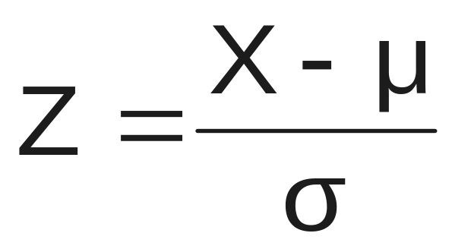
Translation to the Standardized Normal Distribution
Translate from X to the standardized normal (the “Z” distribution) by subtracting the mean of X and dividing by its standard deviation:
The Z distribution always has mean = 0 and standard deviation = 1

Slide 10
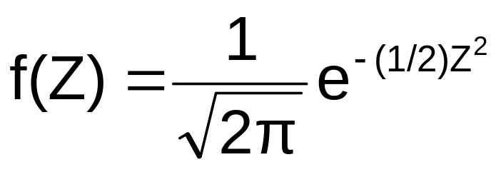
The Standardized Normal Probability Density Function
The formula for the standardized normal probability density function is
Where e = the mathematical constant approximated by 2.71828
π = the mathematical constant approximated by 3.14159
Z = any value of the standardized normal distribution

Slide 11
The Standardized
Normal Distribution
Also known as the “Z” distribution
Mean is 0
Standard Deviation is 1
f(Z)
1
Z
0
Values above the mean have positive Z-values. Values below the mean have negative Z-values.

Slide 12
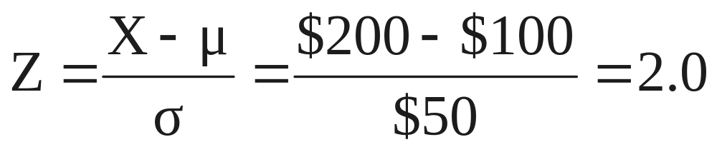
Example
If X is distributed normally with mean of $100 and standard deviation of $50, the Z value for X = $200 is
This says that X = $200 is two standard deviations (2 increments of $50 units) above the mean of $100.

Slide 13
Comparing X and Z units
$100
$200
$X
(μ = $100, σ = $50)
0
2.0
Z
(μ = 0, σ = 1)
Note that the shape of the distribution is the same, only the scale has changed. We can express the problem in the original units (X in dollars) or in standardized units (Z)

Slide 14
Finding Normal Probabilities
Probability is measured by the area under the curve
f(X)
P
(
a
≤
X
≤
b
)
=
P
(
a
<
X
<
b
)
(Note that the probability of any individual value is zero)
a
b
X

Slide 15


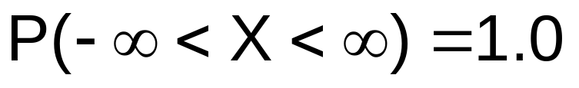
Probability as
Area Under the Curve
The total area under the curve is 1.0, and the curve is symmetric, so half is above the mean, half is below
f(X)
0.5
0.5
μ
X

Slide 16
The Standardized Normal Table
The Cumulative Standardized Normal table in the textbook (Appendix table E.2) gives the probability less than a desired value of Z (i.e., from negative infinity to Z)
0.9772
Example:
P(Z < 2.00) = 0.9772
0
2.00
Z

Slide 17
The Standardized Normal Table
(continued)
The column gives the value of Z to the second decimal point
Z 0.00 0.01 0.02 …
0.0
0.1
The row shows the value of Z to the first decimal point
.
.
.
The value within the table gives the probability from Z = − ∞ up to the desired Z value
2.0
.9772
P(Z < 2.00) = 0.9772
2.0

Slide 18
General Procedure for Finding Normal Probabilities
To find P(a < X < b) when X is distributed normally:
Draw the normal curve for the problem in
terms of X
Translate X-values to Z-values
Use the Standardized Normal Table

Slide 19
Finding Normal Probabilities
Let X represent the time it takes (in seconds) to download an image file from the internet.
Suppose X is normal with a mean of18.0 seconds and a standard deviation of 5.0 seconds. Find P(X < 18.6)
X
18.0
18.6

Slide 20
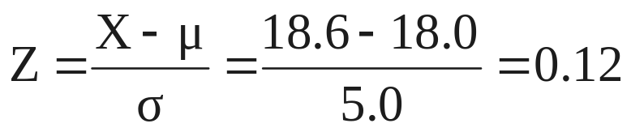
Finding Normal Probabilities
(continued)
Let X represent the time it takes, in seconds to download an image file from the internet.
Suppose X is normal with a mean of 18.0 seconds and a standard deviation of 5.0 seconds. Find P(X < 18.6)
μ = 18
σ = 5
μ = 0
σ = 1
18
18.6
X
0
0.12
Z
P(X < 18.6)
P(Z < 0.12)

Slide 21
Solution: Finding P(Z < 0.12)
Standardized Normal Probability
Table (Portion)
P(X < 18.6)
= P(Z < 0.12)
Z
.00
.01
.02
0.5478
0.0
.5000
.5040
.5080
0.1
.5398
.5438
.5478
0.2
.5793
.5832
.5871
Z
0.3
.6179
.6217
.6255
0.00
0.12

Slide 22
Finding Normal
Upper Tail Probabilities
Suppose X is normal with mean 18.0 and standard deviation 5.0.
Now Find P(X > 18.6)
X
18.0
18.6

Slide 23
Finding Normal
Upper Tail Probabilities
(continued)
Now Find P(X > 18.6)…
P(X > 18.6) = P(Z > 0.12) = 1.0 - P(Z ≤ 0.12)
= 1.0 - 0.5478 = 0.4522
0.5478
1.000
1.0 - 0.5478 = 0.4522
Z
Z
0
0
0.12
0.12

Slide 24
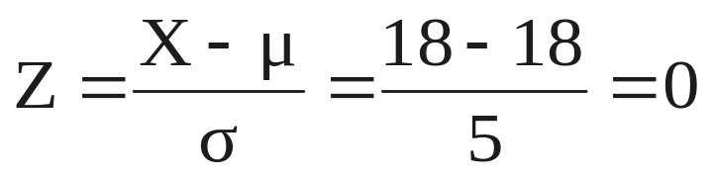
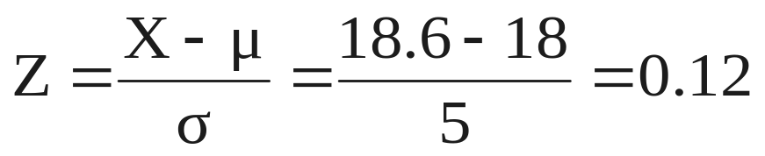
Finding a Normal Probability Between Two Values
Suppose X is normal with mean 18.0 and standard deviation 5.0. Find P(18 < X < 18.6)
Calculate Z-values:
18
18.6
X
0
0.12
Z
P(18 < X < 18.6)
= P(0 < Z < 0.12)

Slide 25
Solution: Finding P(0 < Z < 0.12)
P(18 < X < 18.6)
Standardized Normal Probability
Table (Portion)
= P(0 < Z < 0.12)
= P(Z < 0.12) – P(Z ≤ 0)
Z
.00
.01
.02
= 0.5478 - 0.5000 = 0.0478
0.0
.5000
.5040
.5080
0.0478
0.5000
0.1
.5398
.5438
.5478
0.2
.5793
.5832
.5871
0.3
.6179
.6217
.6255
Z
0.00
0.12

Slide 26
Probabilities in the Lower Tail
Suppose X is normal with mean 18.0 and standard deviation 5.0.
Now Find P(17.4 < X < 18)
X
18.0
17.4

Slide 27
Probabilities in the Lower Tail
(continued)
Now Find P(17.4 < X < 18)…
P(17.4 < X < 18)
= P(-0.12 < Z < 0)
= P(Z < 0) – P(Z ≤ -0.12)
= 0.5000 - 0.4522 = 0.0478
0.0478
0.4522
The Normal distribution is symmetric, so this probability is the same as P(0 < Z < 0.12)
17.4
18.0
X
-0.12
0
Z

Slide 28
Empirical Rule
What can we say about the distribution of values around the mean? For any normal distribution:
f(X)
μ ± 1σ encloses about 68.26% of X’s
σ
σ
X
μ-1σ
μ
μ+1σ
68.26%

Slide 29
The Empirical Rule
(continued)
μ ± 2σ covers about 95.44% of X’s
μ ± 3σ covers about 99.73% of X’s
2σ
2σ
3σ
3σ
μ
x
μ
x
95.44%
99.73%

Slide 30
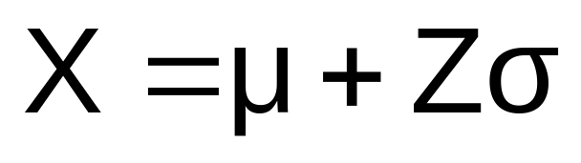
Given a Normal Probability
Find the X Value
Steps to find the X value for a known probability:
1. Find the Z value for the known probability
2. Convert to X units using the formula:

Slide 31
Finding the X value for a Known Probability
(continued)
Example:
Let X represent the time it takes (in seconds) to download an image file from the internet.
Suppose X is normal with mean 18.0 and standard deviation 5.0
Find X such that 20% of download times are less than X.
0.2000
?
18.0
X
?
0
Z

Slide 32
Find the Z value for
20% in the Lower Tail
1. Find the Z value for the known probability
Standardized Normal Probability
Table (Portion)
20% area in the lower tail is consistent with a Z value of -0.84
Z
…
.03
.04
.05
-0.9
…
.1762
.1736
.1711
0.2000
-0.8
…
.2033
.2005
.1977
-0.7
…
.2327
.2296
.2266
?
18.0
X
-0.84
0
Z

Slide 33
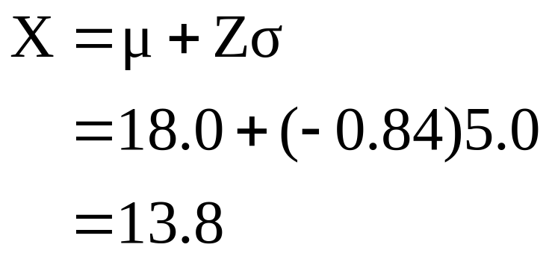
Finding the X value
2. Convert to X units using the formula:
So 20% of the values from a distribution with mean 18.0 and standard deviation 5.0 are less than 13.80

Slide 34
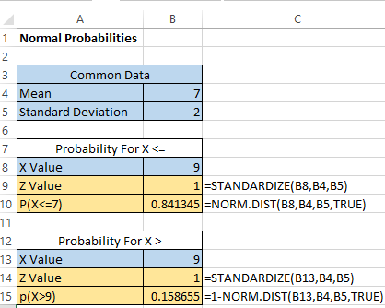
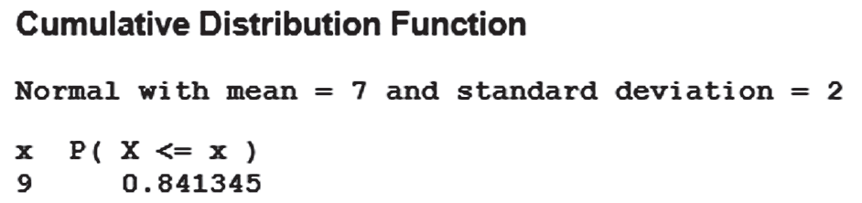
Both Minitab & Excel Can Be Used To Find Normal Probabilities
Find P(X < 9) where X is normal with a mean of 7
and a standard deviation of 2
Excel Minitab

Slide 35
Evaluating Normality
Not all continuous distributions are normal
It is important to evaluate how well the data set is approximated by a normal distribution.
Normally distributed data should approximate the theoretical normal distribution:
  The normal distribution is bell shaped (symmetrical) where the mean is equal to the median.
  The empirical rule applies to the normal distribution.
  The interquartile range of a normal distribution is 1.33 standard deviations.

Slide 36
Evaluating Normality
(continued)
Comparing data characteristics to theoretical properties
Construct charts or graphs
  For small- or moderate-sized data sets, construct a stem-and-leaf display or a boxplot to check for symmetry
  For large data sets, does the histogram or polygon appear bell-shaped?
Compute descriptive summary measures
  Do the mean, median and mode have similar values?
  Is the interquartile range approximately 1.33σ?
  Is the range approximately 6σ?

Slide 37
Evaluating Normality
(continued)
Comparing data characteristics to theoretical properties
Observe the distribution of the data set
  Do approximately 2/3 of the observations lie within mean ±1 standard deviation?
  Do approximately 80% of the observations lie within mean ±1.28 standard deviations?
  Do approximately 95% of the observations lie within mean ±2 standard deviations?
Evaluate normal probability plot
  Is the normal probability plot approximately linear (i.e. a straight line) with positive slope?

Slide 38
Constructing
A Normal Probability Plot
Normal probability plot
  Arrange data into ordered array
  Find corresponding standardized normal quantile values (Z)
  Plot the pairs of points with observed data values (X) on the vertical axis and the standardized normal quantile values (Z) on the horizontal axis
  Evaluate the plot for evidence of linearity

Slide 39
The Normal Probability Plot
Interpretation
A normal probability plot for data from a normal distribution will be approximately linear:
X
90
60
30
-2
-1
0
1
2
Z

Slide 40
Normal Probability Plot
Interpretation
(continued)
Left-Skewed
Right-Skewed
X
90
X
90
60
60
30
30
-2
-1
0
1
2
Z
-2
-1
0
1
2
Z
Rectangular
Nonlinear plots indicate a deviation from normality
X
90
60
30
-2
-1
0
1
2
Z

Slide 41
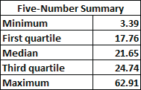
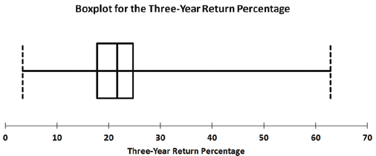
Evaluating Normality
An Example: Mutual Fund Returns
The boxplot is skewed to the right. (The normal distribution is symmetric.)

Slide 42
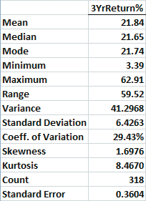
Evaluating Normality
An Example: Mutual Fund Returns
(continued)
The mean (21.84) is approximately the same as the median (21.65). (In a normal distribution the mean and median are equal.)
The interquartile range of 6.98 is approximately 1.09 standard deviations. (In a normal distribution the interquartile range is 1.33 standard deviations.)
The range of 59.52 is equal to 9.26 standard deviations. (In a normal distribution the range is 6 standard deviations.)
77.04% of the observations are within 1 standard deviation of the mean. (In a normal distribution this percentage is 68.26%.)
86.79% of the observations are within 1.28 standard deviations of the mean. (In a normal distribution this percentage is 80%.)
96.86% of the observations are within 2 standard deviations of the mean. (In a normal distribution this percentage is 95.44%.)
The skewness statistic is 1.698 and the kurtosis statistic is 8.467. (In a normal distribution, each of these statistics equals zero.)
Descriptive Statistics

Slide 43
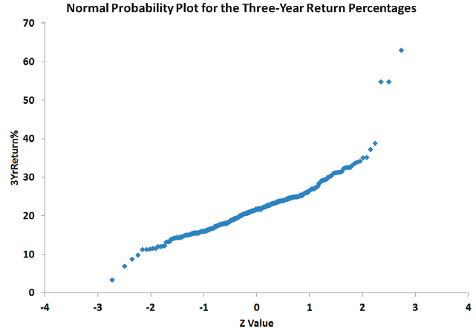
Evaluating Normality Via Excel
An Example: Mutual Fund Returns
(continued)
Excel (quantile-quantile) normal probability plot
Plot is not a straight line and shows the distribution is skewed to the right. (The normal distribution appears as a straight line.)

Slide 44
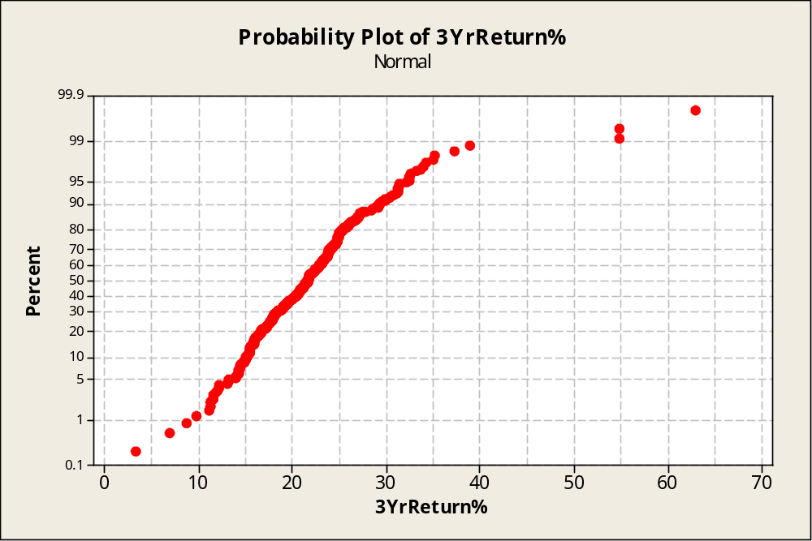
Evaluating Normality Via Minitab
An Example: Mutual Fund Returns
(continued)
Normal Probability Plot From Minitab
Plot is not a straight line, rises quickly in the beginning, rises slowly at the end and shows the distribution is skewed to the right.

Slide 45
Evaluating Normality
An Example: Mutual Fund Returns
(continued)
Conclusions
  The returns are right-skewed
  The returns have more values concentrated around the mean than expected
  The range is larger than expected
  Normal probability plot is not a straight line
  Overall, this data set greatly differs from the theoretical properties of the normal distribution

Slide 46
Chapter Summary
In this chapter we discussed:
Computing probabilities from the normal distribution
Using the normal distribution to solve business problems
Using the normal probability plot to determine whether a set of data is approximately normally distributed

